Slide 1
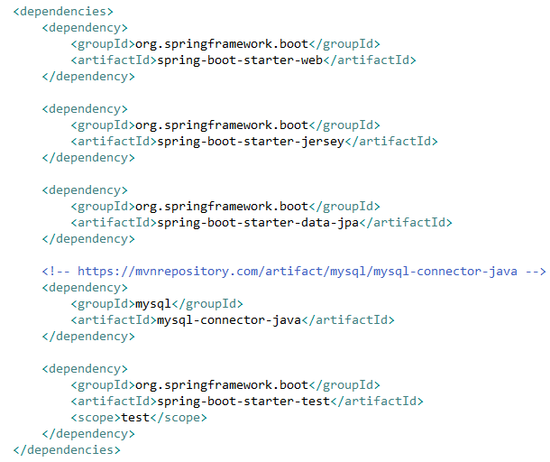
Spring Boot Jersey Example

Slide 2
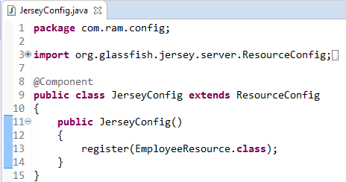
Spring Boot Jersey Example
Now we have a JAX-RS resource and we want to access it from spring boot application which include Jersey dependency. Let’s register this resource as Jersey resource.
Look at the @Component annotation. It enables this class to be registered while spring boot auto scans the java classes in source folder.
ResourceConfig provides advanced capabilities to simplify registration of JAX-RS components.

